Slide 1
Tree Algorithm
Computational Astrophysics
Group 03
謝博安 游柏仁 廖品淳

Slide 2
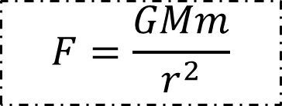
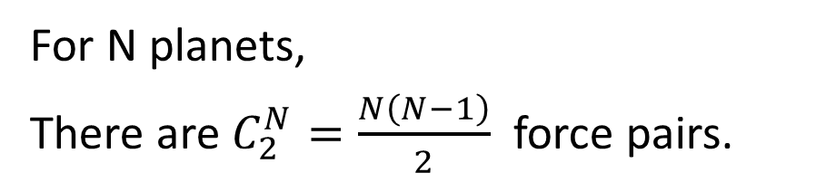
Introduction
To simulate planetary motion,
we go through each planet to inspect the force.
1
2
For N planets,
There are $C_{2}^{N}=\frac{N\left(N−1\right)}{2}$ force pairs.
5
3
$$F=\frac{GMm}{r^{2}}$$
4
No matter the distance is,
calculating force pairs will consume a lot of time when N is large.

Slide 3
What is Tree Algorithm?
To accelerate the part for force calculation, Tree Algorithm group distant particles into ever larger cells, allowing their gravity to be accounted for by means of a single multipole force.

Slide 4
Outline
Initialize N particles (x, v)
In each time iteration
Compute a bounding box of all particles
Divide particles into cells
Compute center of mass and cumulative mass for each cell
Compute force for each particles
Update (x, v) for each particles
plot

Slide 5
How to insert?
When the Square contains more than 1 particle, then turn the original square into 4 children squares.

Slide 6
Compute Center of Mass
Reduce the number of particles for calculation
Particles: 5
Center of Mass:3
Level

Slide 7
Calculate Force pairs
node.body
(neighbor particles )
body
Empty
Body
None
Identify neighbor particles (node.body)
>> stops at the same level of Tree
1. Body : 1 particle
2. None : No
>> stops at another level of Tree (children)
3. Empty : used to have 1 particle
Level

Slide 8
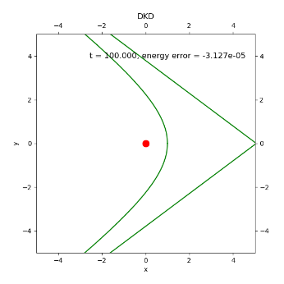

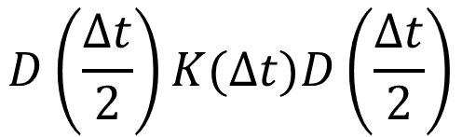
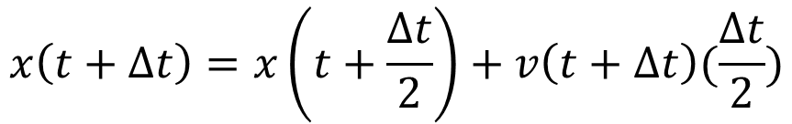
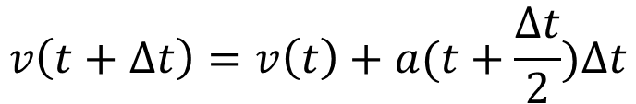
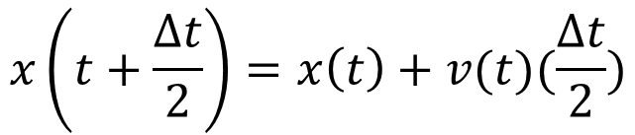
Update motion of particles
DKD scheme:
$$D\left(\frac{∆t}{2}\right)K(∆t)D\left(\frac{∆t}{2}\right)$$
$$x\left(t+\frac{∆t}{2}\right)=x\left(t\right)+v(t)(\frac{∆t}{2})$$
$$v\left(t+∆t\right)=v\left(t\right)+a(t+\frac{∆t}{2})∆t$$
$$x\left(t+∆t\right)=x\left(t+\frac{∆t}{2}\right)+v\left(t+∆t\right)(\frac{∆t}{2})$$
Green curve: The analytical solution simulates the ideal elliptical orbit of a particle
around a central mass

Slide 9

Our Tree Algorithm
>> Python (2 dimensional )
Details of Tree works well … Check center of mass
Generate the animation
# Link to Github
>> C++ (3 dimensional )
Already known the outcome of initial condition (3D)
Parallelization (Threads)
# Link to Github

Slide 10
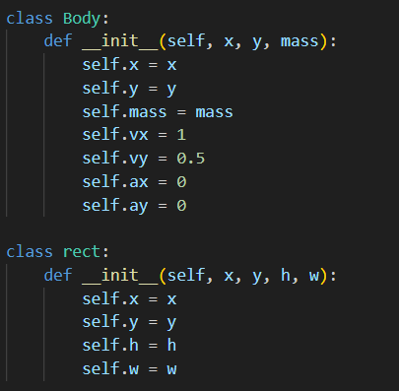
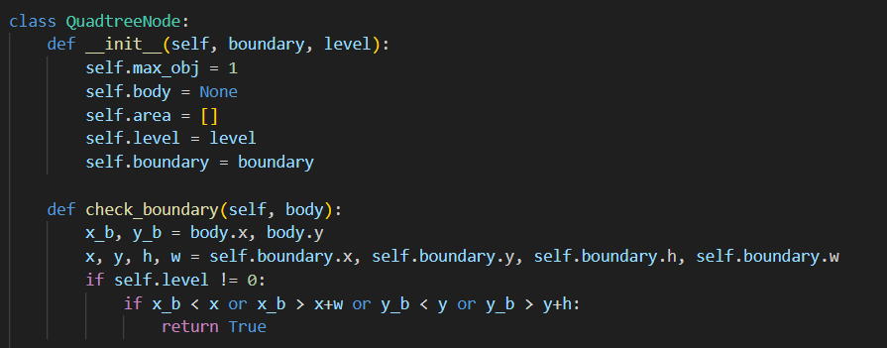
Our Tree Algorithm [Python]
Define the properties of particles & Space
Set some initial conditions
Each square contains merely up to 1 particle
and check if the particle is inside the boundary for the following.

Slide 11
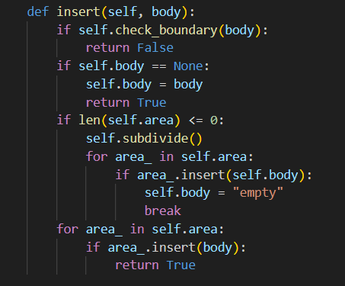
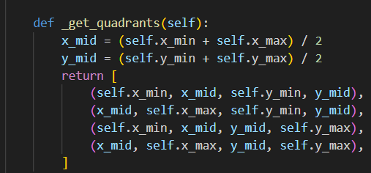
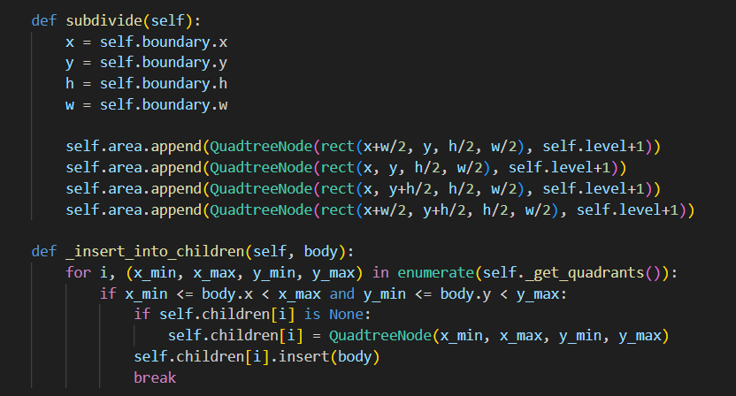
Our Tree Algorithm [Python]
Insert particle
>> Identify the body one by one
Check the boundary first
If the square are contains more than one,
then subdivide the square.
Subdivide: 1 square generates 4 children squares.
Put those particles into new squares.

Slide 12
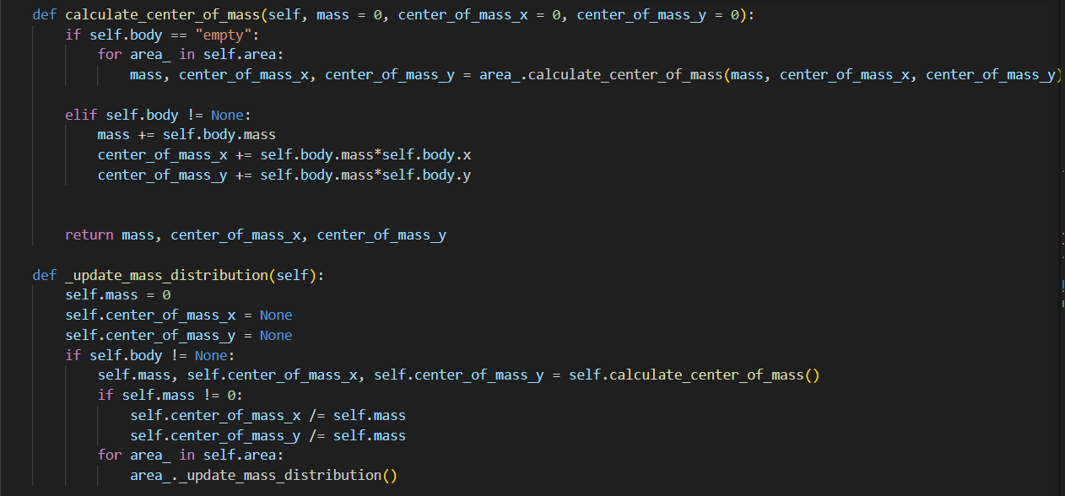
Our Tree Algorithm [Python]
Run through the square areas
If the square has children, then calculate the center of mass and update the mass distribution

Slide 13
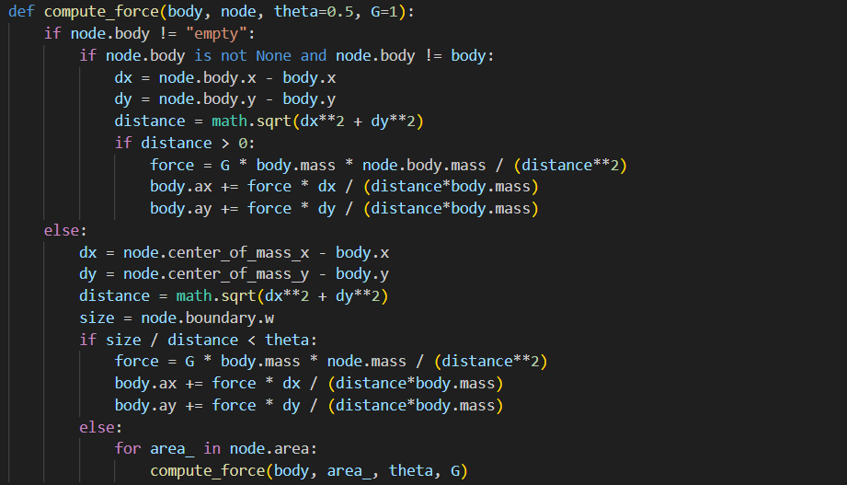
Our Tree Algorithm [Python]
Run through the area and check the type of it
If it is “empty” (children),
then we have to check the size/distance < theta:
If it True: then calculate the force; otherwise, check the children

Slide 14
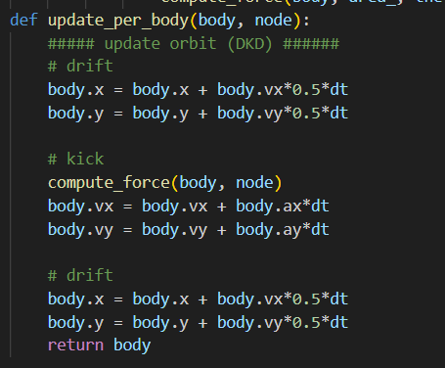
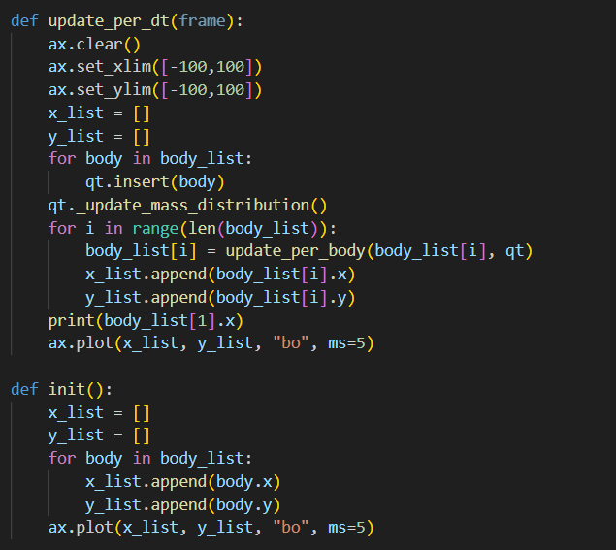
Our Tree Algorithm [Python]
Update the motion by DKD scheme
Plot [Output]
Define every things to do in the time iteration
Input some certain initial condition

Slide 15
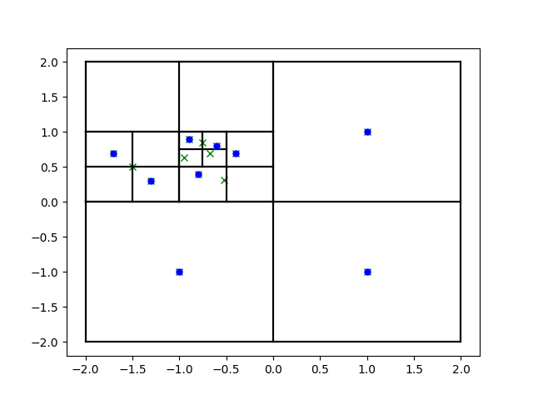
Results of our Tree
>> Python (2 dimensional )
Plot center of mass
Animation of different N particles vs Time
1 thread 1000iterations Theta = 0.05, T= 80s
Parallelize
N=10, 32 threads 1000iterations Theta = 0.05, T= 10s
N=10^4, 32 threads 1000iterations Theta = 0.05, T= 600s
Fixed N but Change Theta
>> C++ (3 dimensional )
Animation of different N particles vs Time
Parallelize 1.
Fixed N but Change Theta

Slide 16


Problems we met
>> Python (2 dimensional)
Fail to run the file in the form of Cython
Familiar “multithreading” &“multiprocessing” in Python
>> C++ (3 dimensional)
the outcome Not corresponds to Already known
of initial condition (3D)
Discussion & Check lines of programming again
>>Typing Error in the acceleration part
Notes:
thread = a flow of execution. Like a separate order of instructions.
# However each thread takes a turn running to achieve concurrency
# GIL = (global interpreter lock),
# allows only one thread to hold the control of the Python interpreter at any one time
# cpu bound = program/task spends most of it's time waiting for internal events (CPU intensive)
# use multiprocessing
# io bound = program/task spends most of it's time waiting for external events (user input, web scraping)
# use multithreading

Slide 17
Reference
Content of Tree Algorithm
The cosmological simulation code GADGET-2:
https://www.mpa.mpa-garching.mpg.de/gadget/gadget2-paper.pdf
Cosmology Applications – N body simulations
http://cds.iisc.ac.in/wp-content/uploads/Cosmology.pdf
碰撞檢測的優化-四叉樹(Quadtree)
https://davidhsu666.com/archives/quadtree_in_2d/
Content of DKD scheme
Lecture 06 slides [Computational Astrophysics]
Content of parallelization in C++
Lecture 07 08 slides [Computational Astrophysics]
Content of parallelization in python
Multithreading & Multiprocessing https://youtu.be/3dEPY3HiPtI?si=EGepGsCF-YKEBDyQ

Slide 18
Thank you !

Slide 19
Work distribution
廖品淳 | 謝博安 | 游柏仁
Having some discussions online preliminarily and some Face-to-face conversations to discuss the project
Literature Review | 2D Python programming | 3D C++ programming
Programming Debug & Plotting the simulation results | Proposing the main algorithm | Providing initial condition with predicable results
Preparing presentation slides | Modularize file | Parallelization 3D Model

Slide 20
How to insert?

